Slide 1
HUDware
Midway Design Review
Senior Design Project
Team 6
Fall 2016

Slide 2
HUDWare
Heads Up Display for skiing
Allows user to interface with their phone in a hands free setting
Notes:
TELL JORI’S STORY

Slide 3



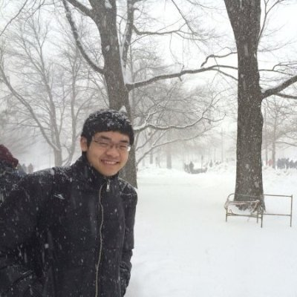
The Team
Sanghoon Lee
Microcontroller
Camera
David Meschisen
Projector/Display
Power System
Jori Platt
Wink Detector
Camera
Minwo Wang
Phone App
Communication
Notes:
David

Slide 4
Previous Block Diagram
Notes:
David

Slide 5
Redesigned Block Diagram
Notes:
David, make sure to clarify the mixed parts

Slide 6
System Requirements
Lightweight attachment to your ski goggles (less than 100g)
Desired operational temperature range (-20°C to 30°C)
Low power consumption (less than 4 watts)
Duration (~4 hours)
Unobstructed view
High bandwidth (at least 300 kB seconds)
Notes:
Sanghoon

Slide 7
Power Budget
Expected Power Consumption:
MCU: .5 W - .7 W (worst case 1 W)
OLED Display: 1 mW (worst case 2 mW)
IOIO: 2.5 W
Total: 4 W = 16 Wh
Battery choice: Lithium-ion AA Batteries
3.1 Wh
Minimum 6 batteries
Notes:
David

Slide 8
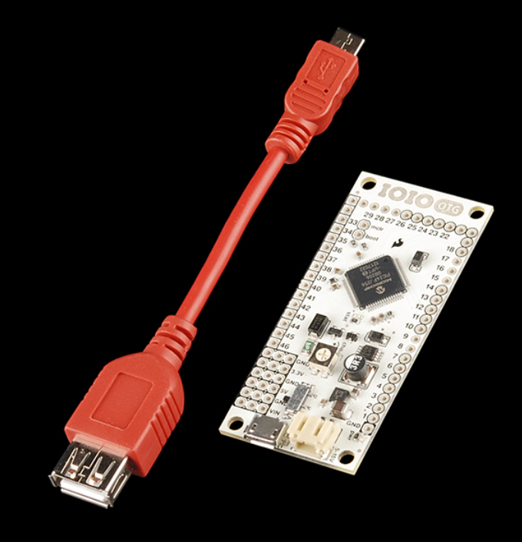
Android IOIO-OTG
An I/O board for Android phones
USB Connection and Configuration
46 GPIO Pins
Two pairs of UART pins
SPI, TWI, Analog Input, etc
IOIO Over OpenAccessory
One-way latency: 4ms ->1ms
Throughput: 300kB/s ->600kB/s
Notes:
Minwo

Slide 9
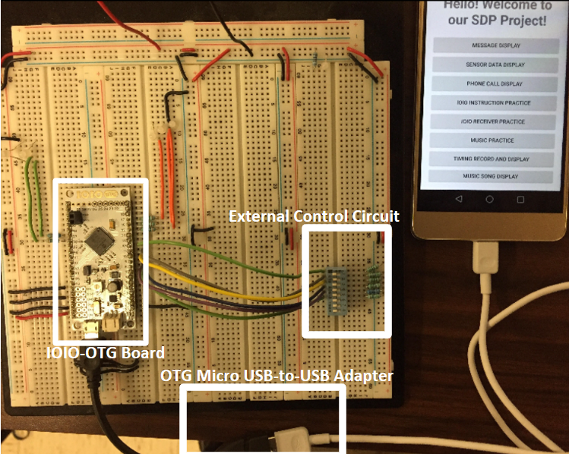
IOIO Demo Circuit

Slide 10
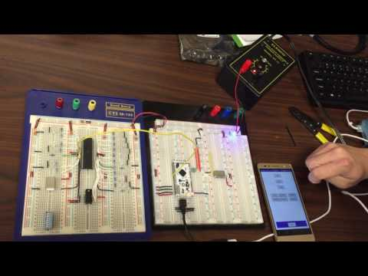
IOIO Transmitter(Phone App to Microcontroller)
GPIO Pins
UART Pins
Notes:
Minwo

Slide 11
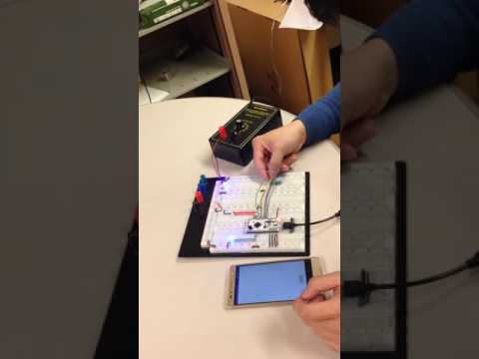
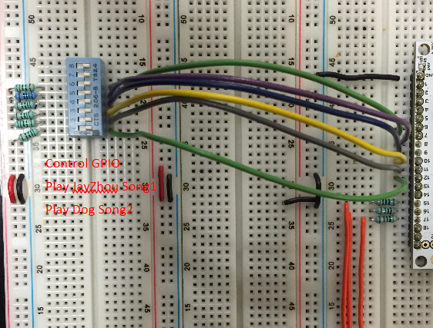
IOIO Receiver(External Circuit to Phone App)
Control GPIO Pins
Play Music
Change song
Notes:
Minwo

Slide 12
IOIO Communication
Requirements:
Provide Serial Data Transmission
Stable USB Connection
AOA Protocol over ADB Protocol
Read GPIO input and Analog Input
Write GPIO Output
Notes:
Minwo

Slide 13
Future Work
Combine IOIO Transmitter with MCU (1/28/2017)
Combine IOIO Receiver with Wink Detection (1/28/2017)
Process Images and Test Bandwidth (2/07/2017)
Notes:
Minwo

Slide 14
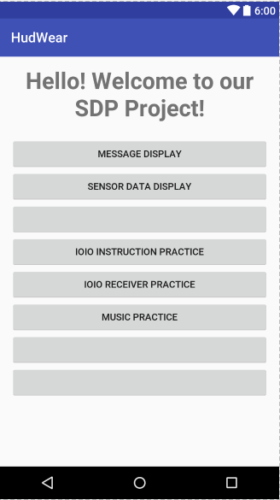
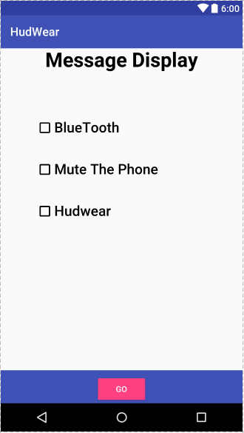
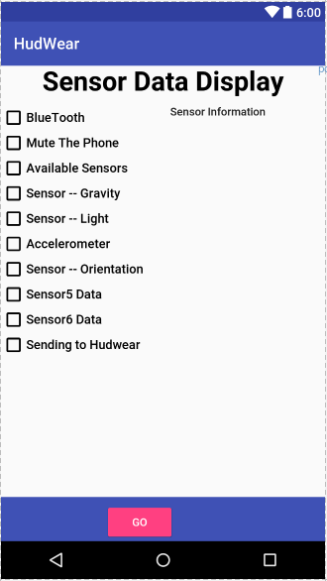
Phone App - Layout
Notes:
Minwo

Slide 15
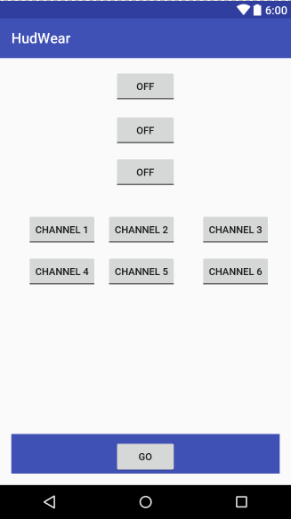
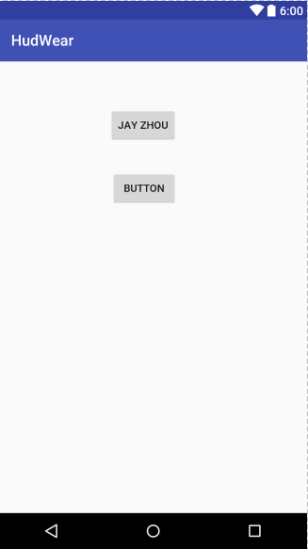
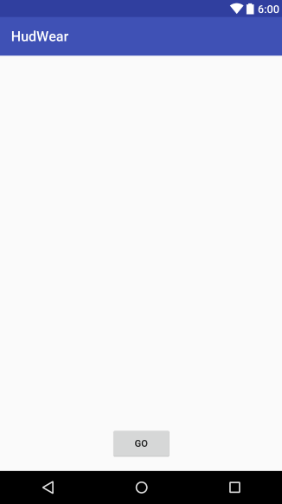
Phone App - Layout 2
Transmitter
Music Player
Receiver
Notes:
Minwo

Slide 16
Future Work
Add more functions to phone app (1/28/2017)
Play more songs
Change the song volume or sequence
Mute the phone, etc
Manage the Layout (1/28/2017)
Notes:
Minwo

Slide 17
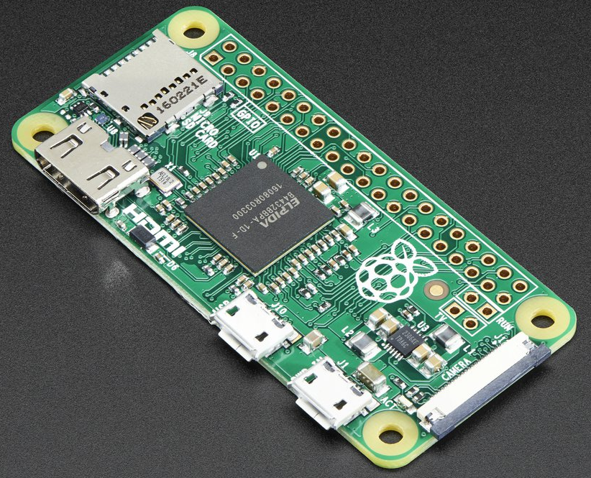
MCU
Raspberry Pi Zero
Broadcom BCM2835 application processor with 1 GHz ARM1176JZF-S core
512MB of LPDDR2 SDRAM
65mm x 30mm x 5mm
Weight: 9g
Power (typical): 5V @ 100 mA
Notes:
Sanghoon

Slide 18
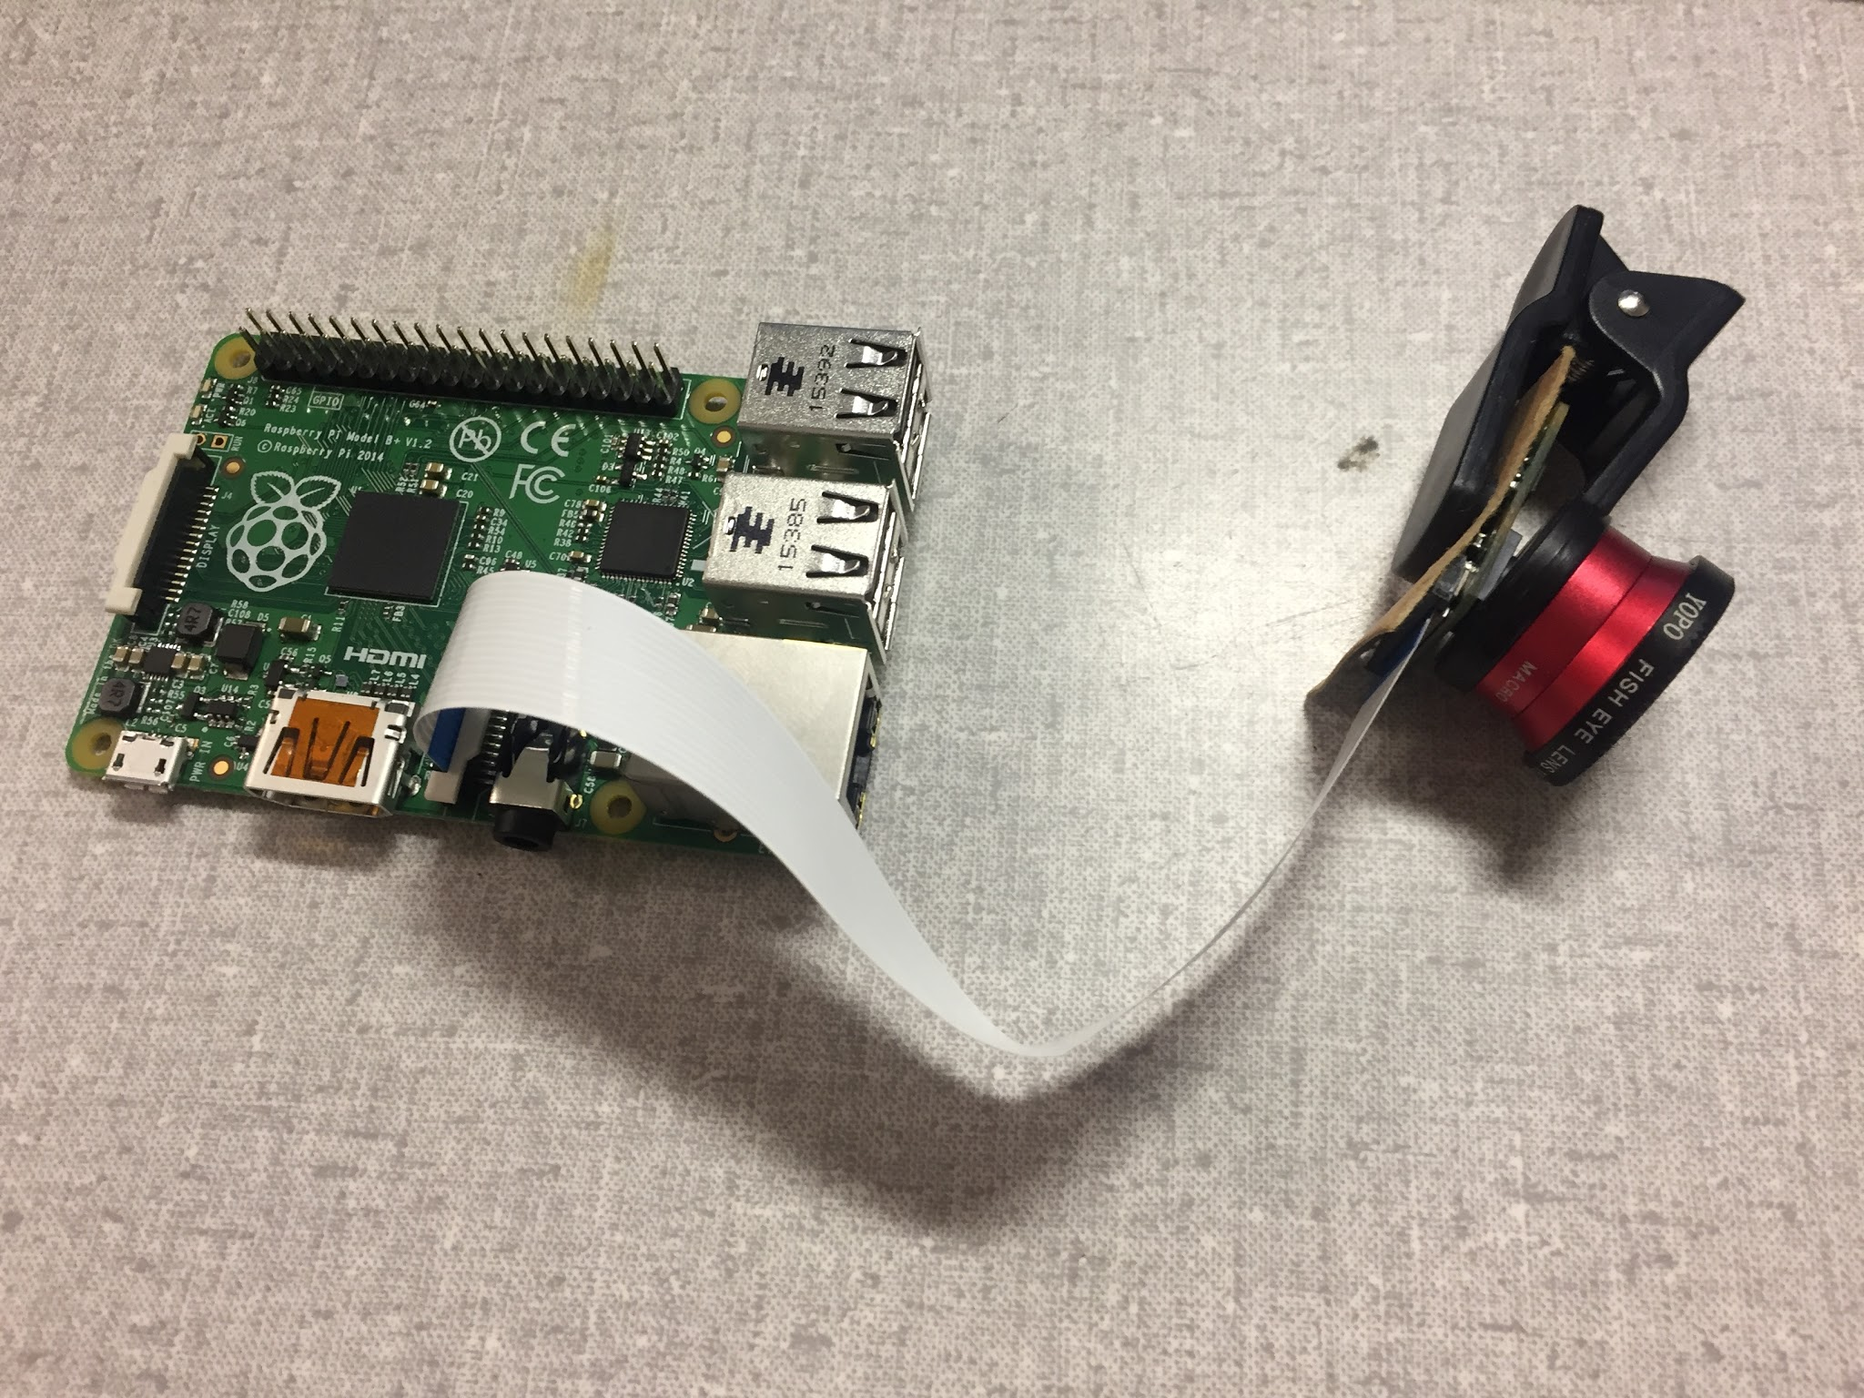
MCU
Notes:
Sanghoon

Slide 19
MCU
Requirements:
Maintain communication link between phone app and OLED display
Drive PiCamera
Support both Wink Detection & OLED Display libraries
MCU Temperature: less than 80°C
Operating temperature range: -20°C to 30°C
Power consumption: less than 1 W
Upper bound memory consumption: ~50% of RAM
Size: less than 80mm x 80mm x 10mm
Notes:
Sanghoon

Slide 20
MCU
RPi B+ Performance:
Code imported
Memory Usage (Maximum):
9-10% - process 1 image
12-13% - process 5 images
2.5% - display 1 image (128x128)
Temperature stable around 39°C
Power consumption: about .5-.7 W
Notes:
Sanghoon
Communication with OLED display established (SPI)
Serial communication established between phone
PiCamera captures images and processes it in Wink Detection code

Slide 21
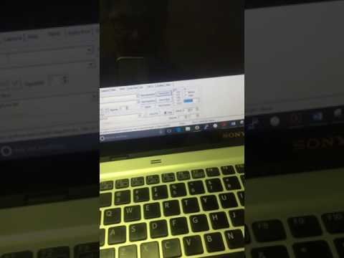
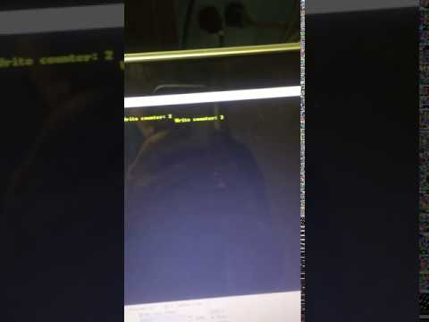
MCU Serial Data Transmission
Laptop -> Raspberry Pi Serial
Raspberry Pi -> Laptop Serial
Notes:
Sanghoon

Slide 22
MCU
Future Goals:
Move over into RPi Zero (1/22/17)
Receive constant stream of image content from phone (1/29/17)
Implement scheduling between OLED display and Wink Detection (1/10/17)
Integrate into goggles (2/12/17)
Notes:
Sanghoon

Slide 23
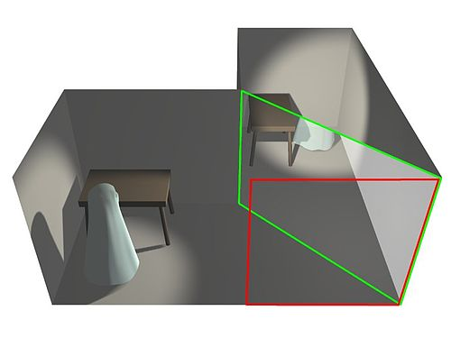
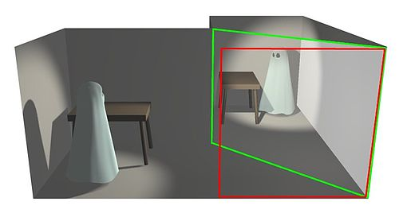
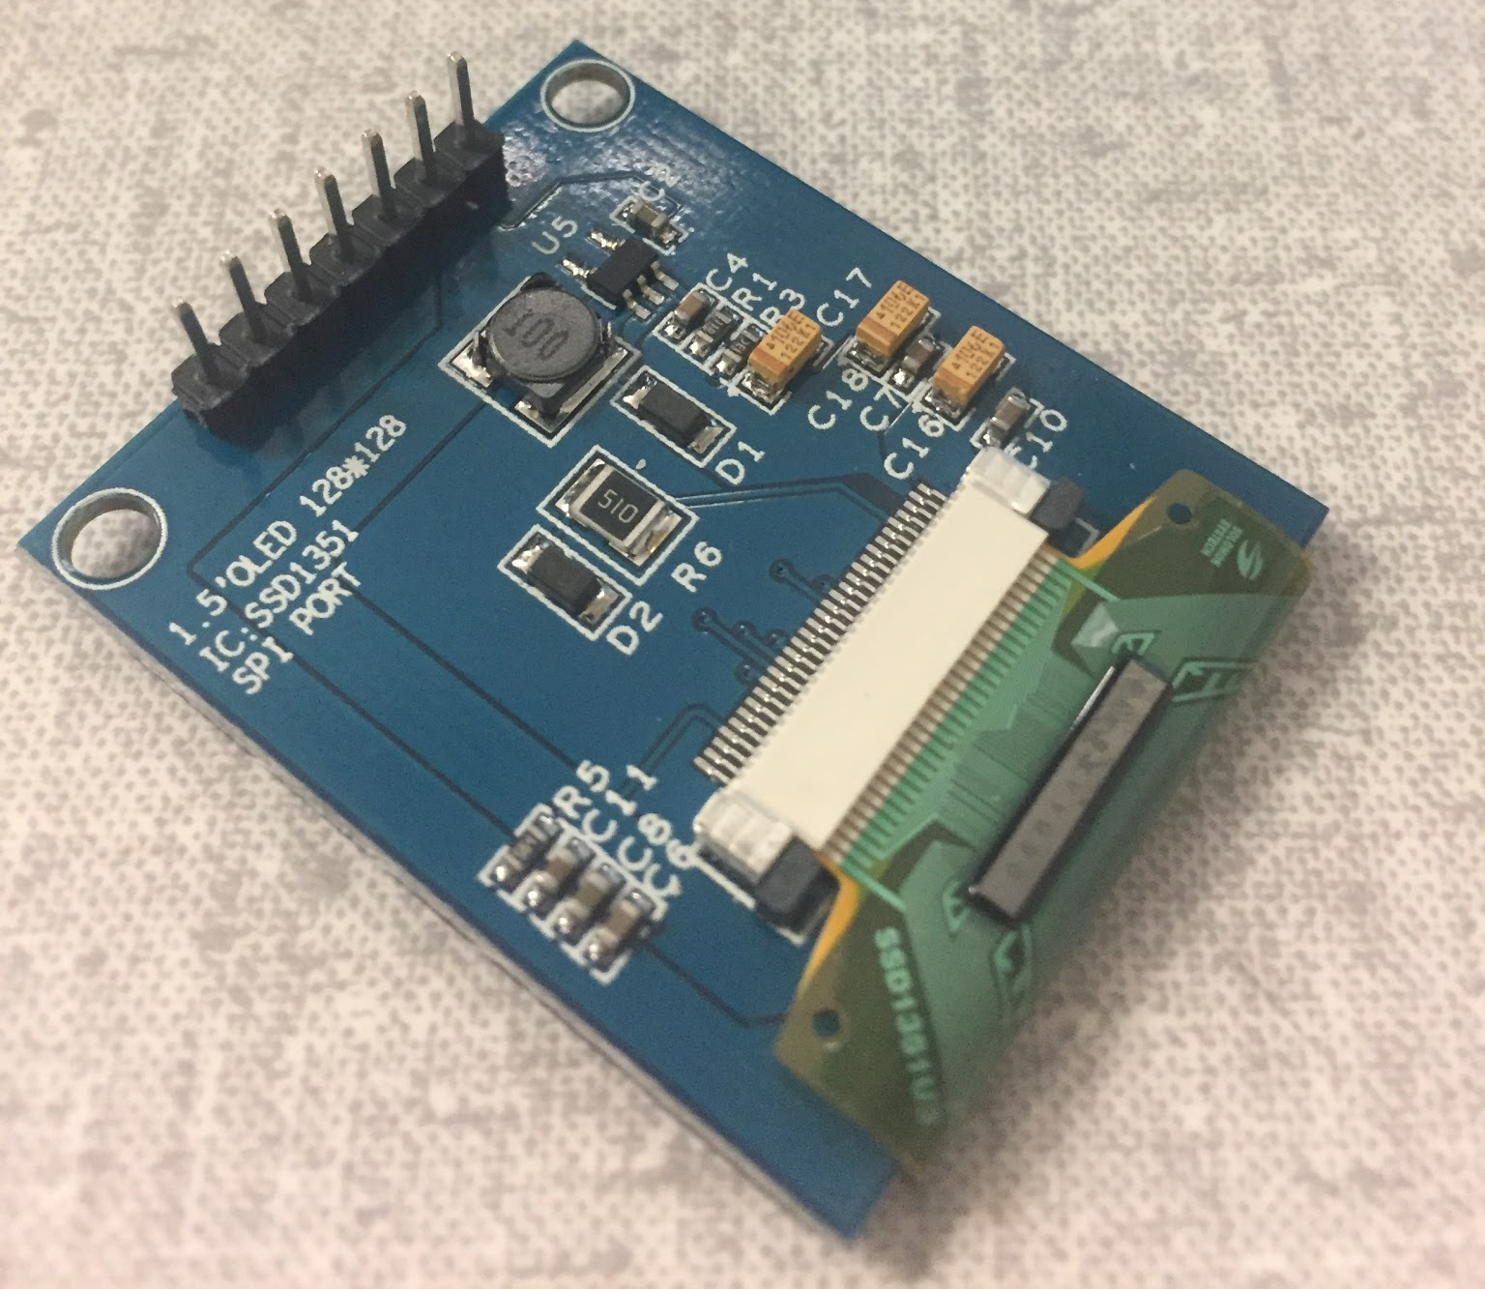
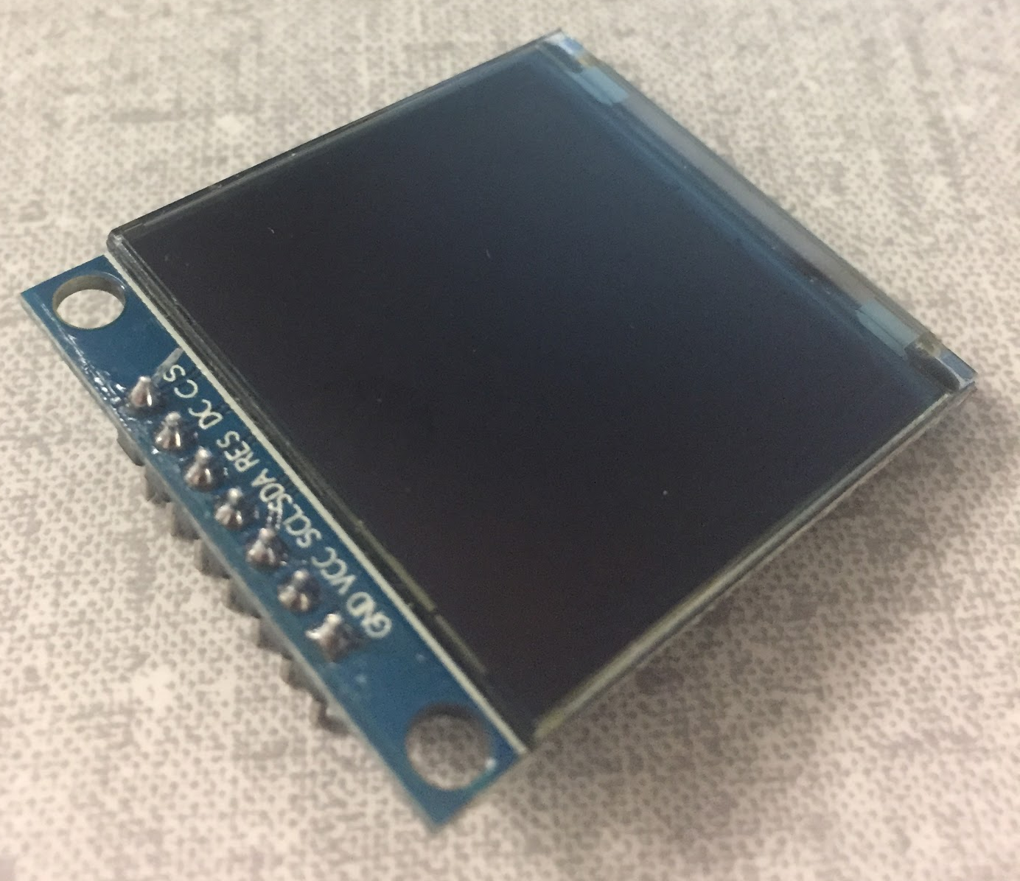
Augmented Reality Display
Opaque backed OLED display
SSD1351 Display Driver
OLED dimension: 30mm x 40mm
128x128 pixel size
Utilizes Pepper’s Ghost Effect
Notes:
David

Slide 24
Augmented Reality Display
Requirements:
Focused & legible display (Image & Text)
Minimum: 120 nits = 120 cd/m²
Target Range: 200 - 300 nits = 200 - 300 cd/m²
Operating temperature range: -20°C to 30°C
Size: less than 50mm x 50mm
Power Consumption: less than 1W
*The candela per square metre (cd/m2) is the derived SI unit of luminance. The unit is based on the candela, the SI unit of luminous intensity, and the square metre, the SI unit of area. Nit (nt) is a non-SI name also used for this unit (1 nt = 1 cd/m2). (Wikipedia)
Notes:
David

Slide 25
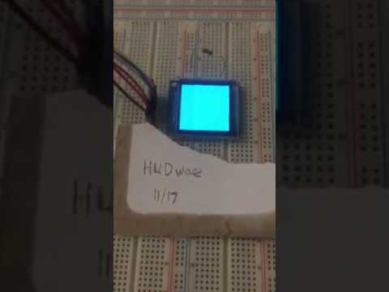
Augmented Reality Display
Notes:
David

Slide 26
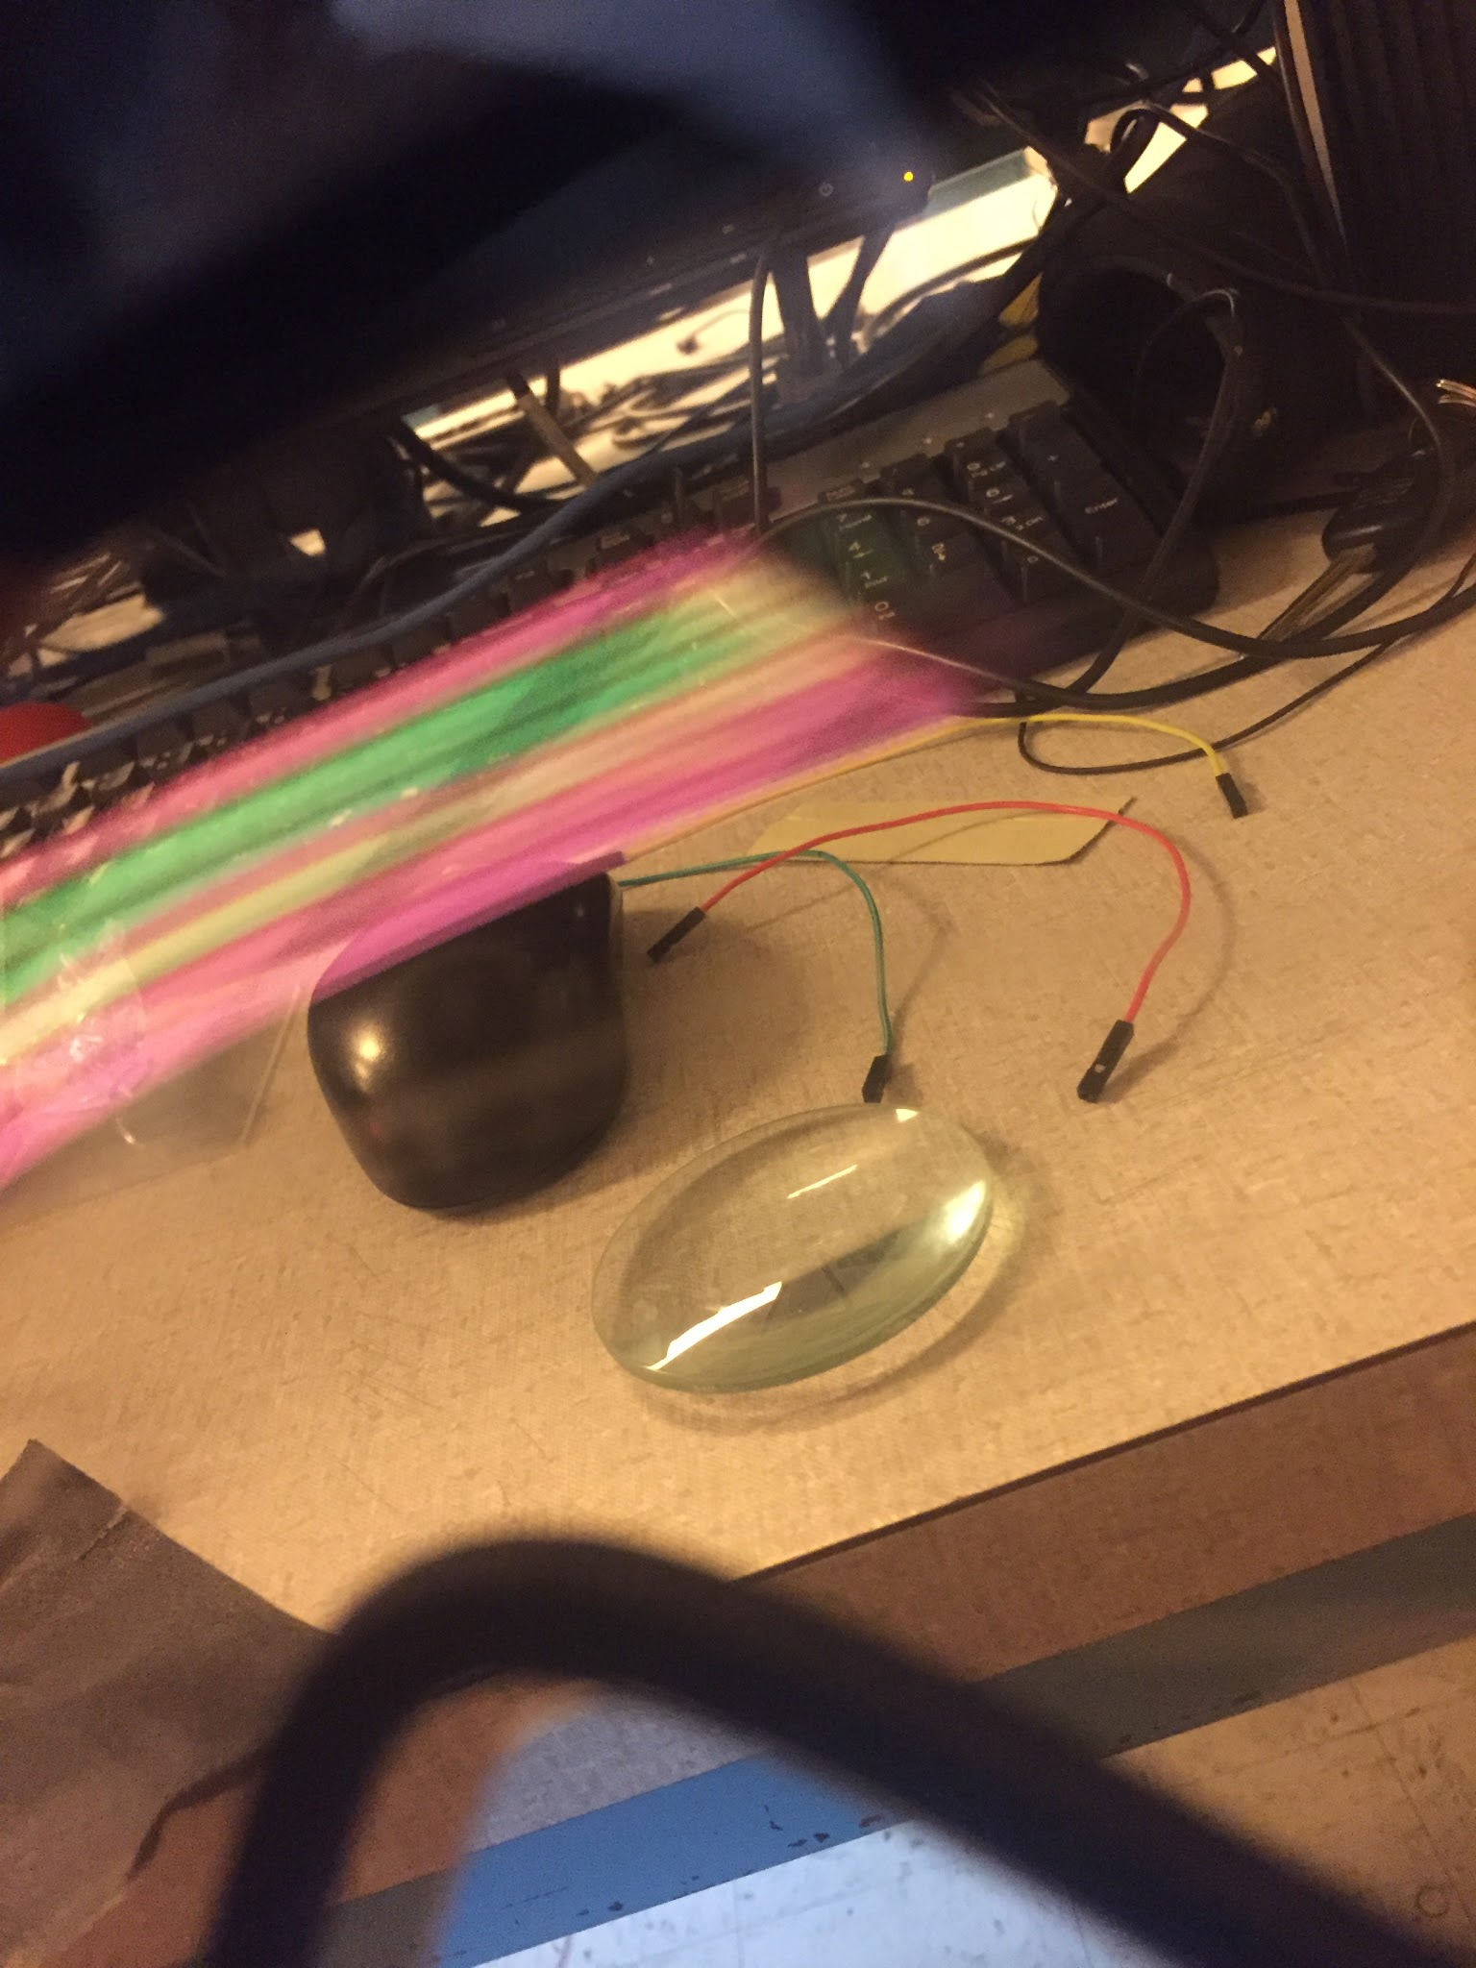
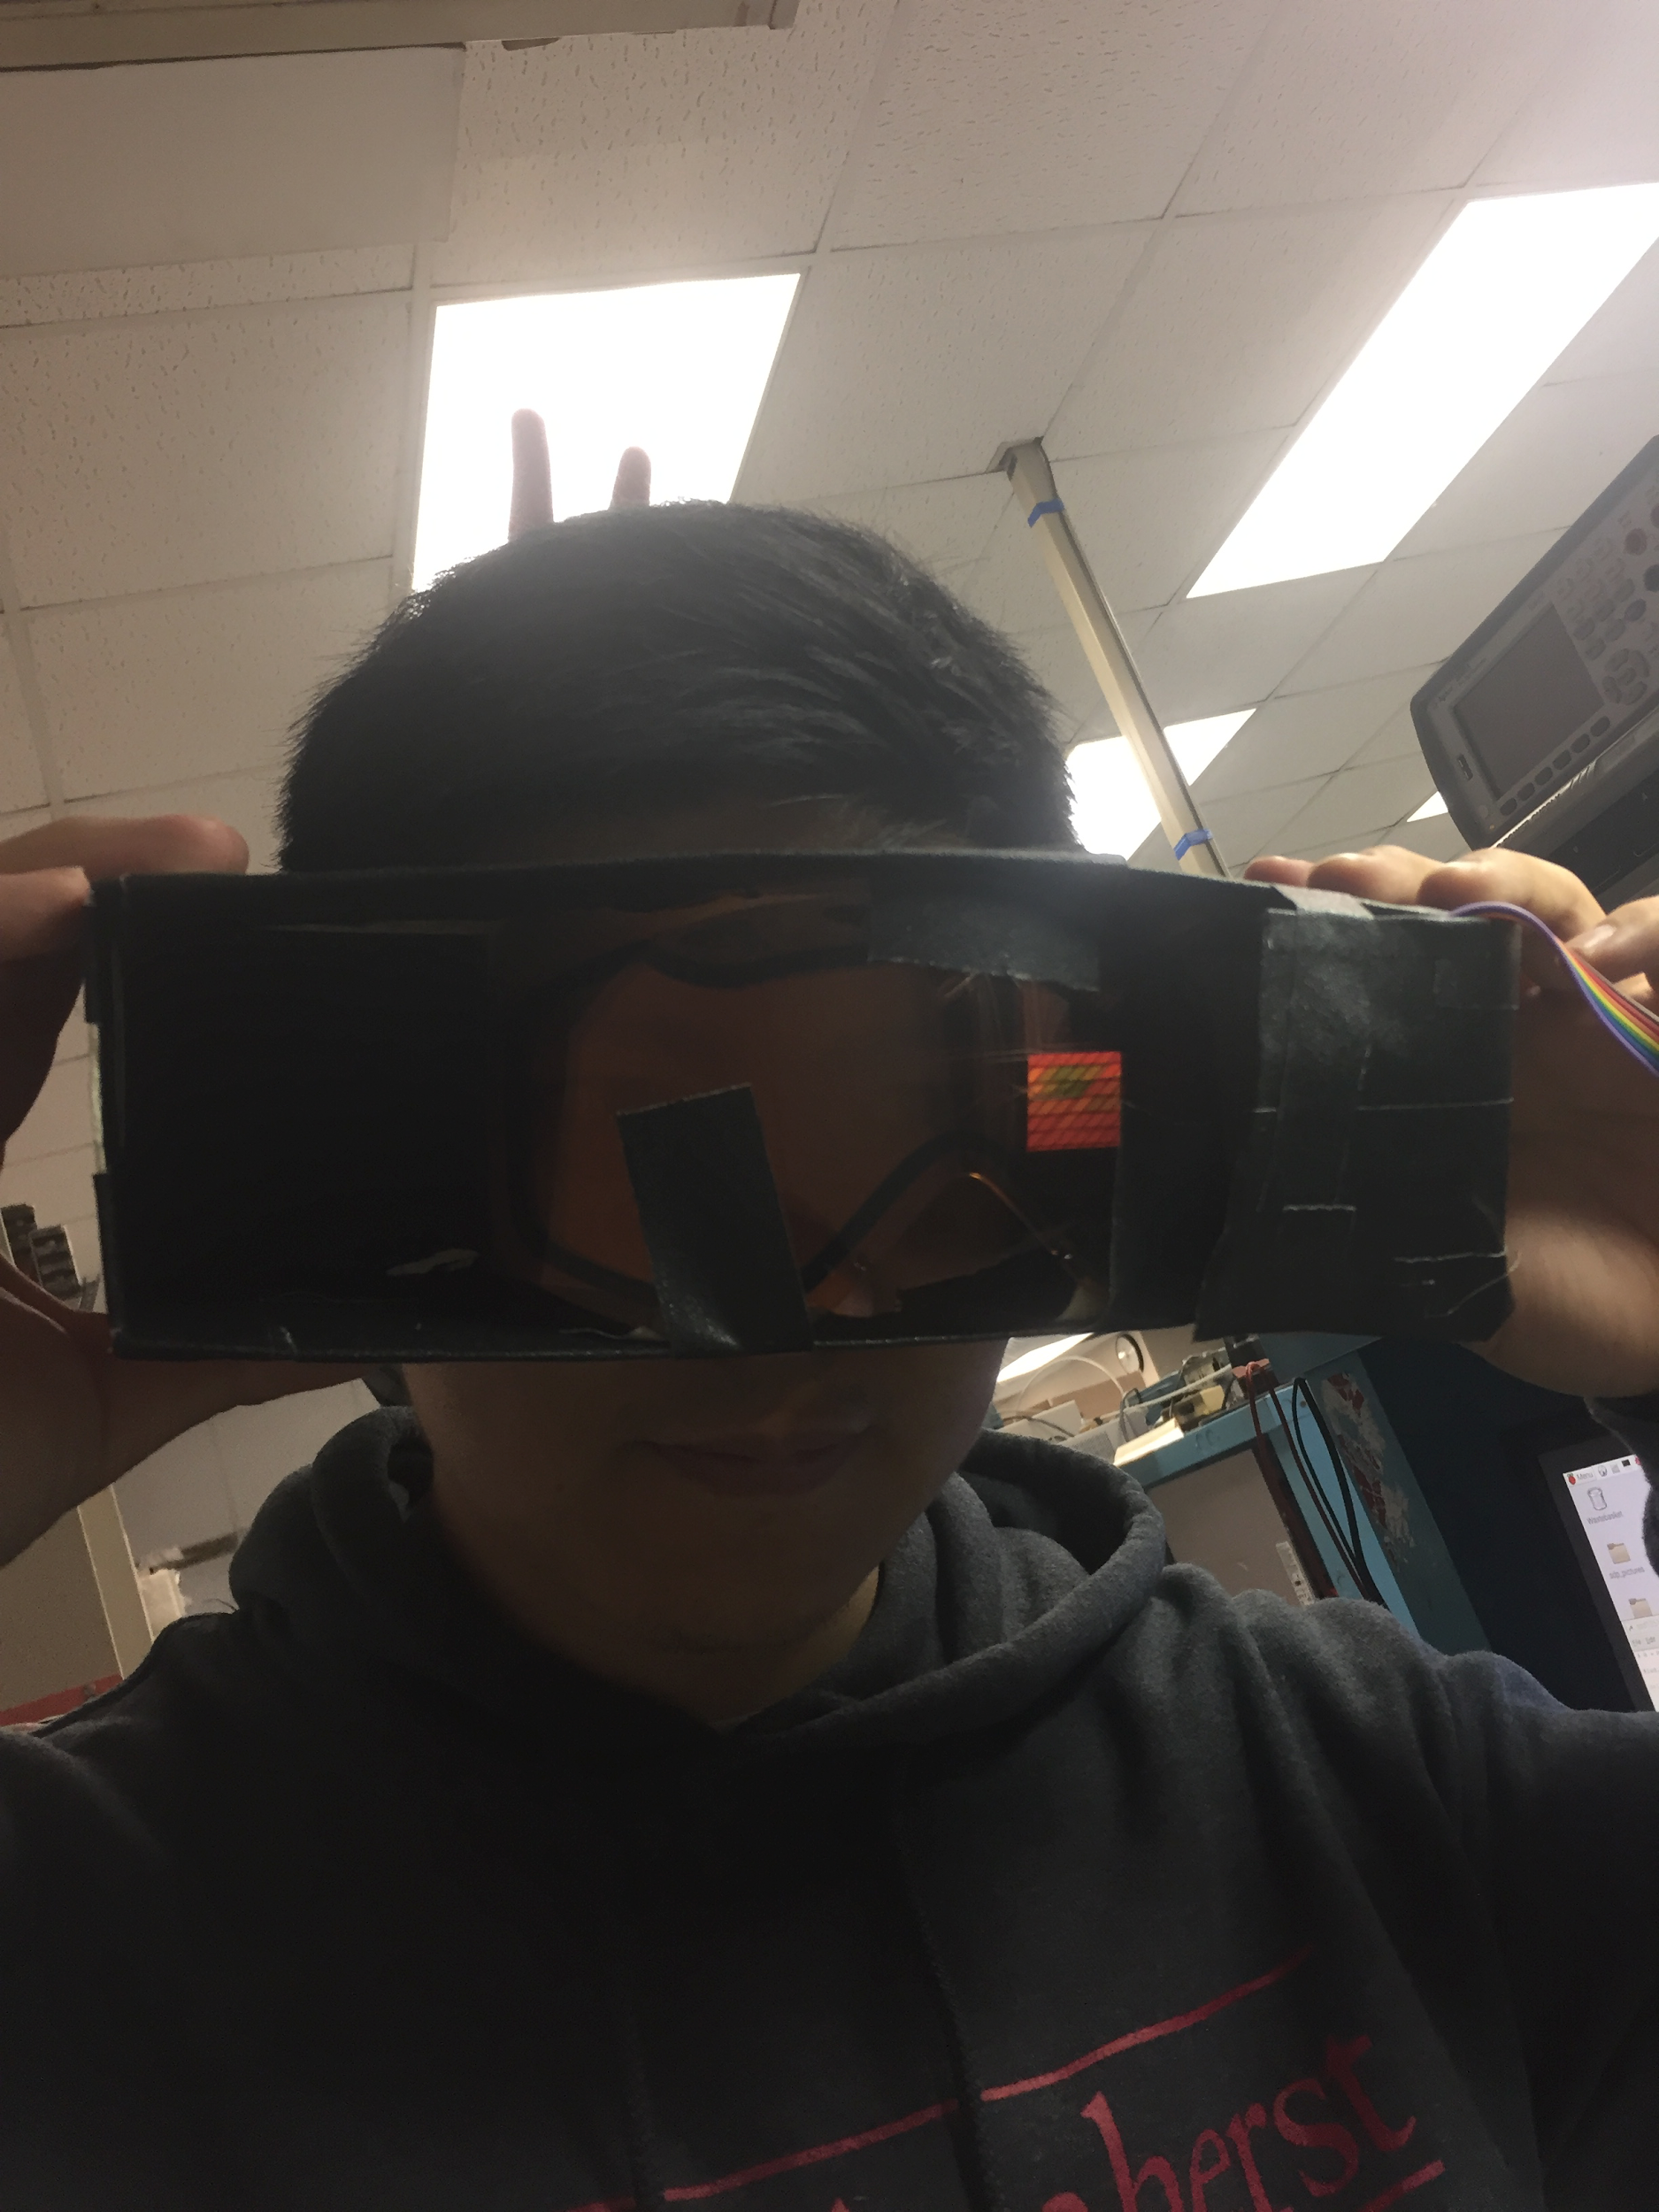
Augmented Reality Display
Notes:
David

Slide 27
Augmented Reality Display
Future Goals:
Optimize Lens/Reflection (1/22/17)
Focus the image on the inside of the goggle (1/29/17)
Optimize conditions for maximum brightness/contrast (1/29/17)
Light Meter for calibrations
Receive constant/updated image content from phone/MCU (2/8/17)
Notes:
David

Slide 28
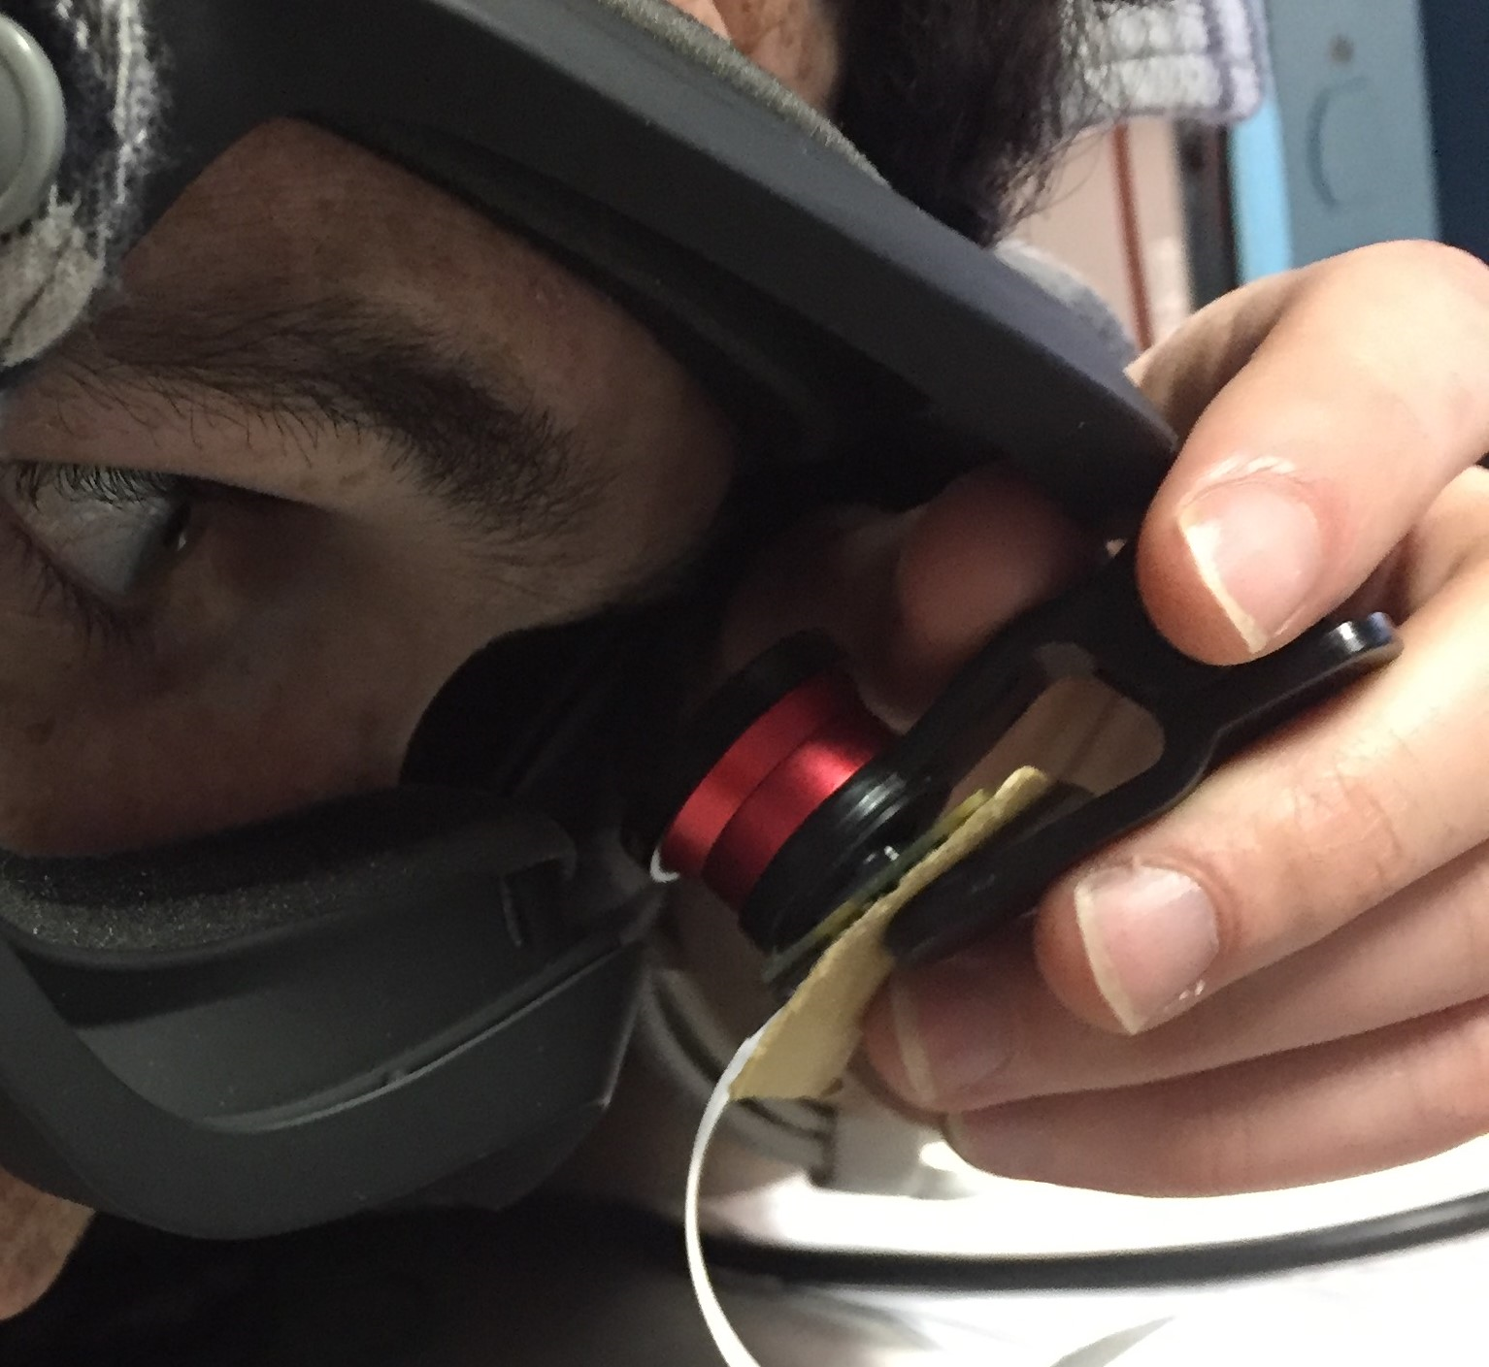
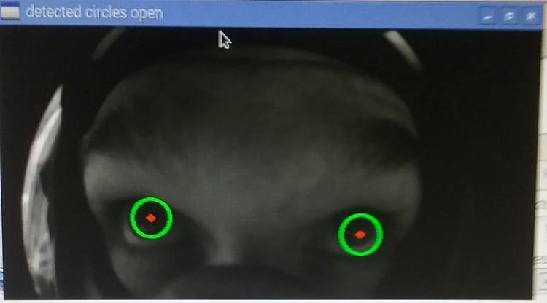
Wink Detector
Detects if an eye is open or closed
Sends command signal if right or left wink
Notes:
Jori

Slide 29
Wink Detector
Requirements:
Accurate - Reads at least 90% of frames correctly
Quick - Reads frame in 0.25 seconds or less
Min 2FPS - Total time between image capture and analysis less than .5 seconds
Output control signals to the phone
Notes:
Jori

Slide 30
Wink Detector
Detection Performance Statistics
Closed eye 100%
Open 79%
Wink 80%
Time
.1427s analysis of image
Notes:
Jori

Slide 31
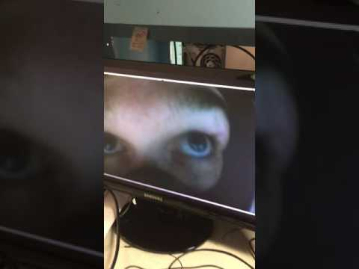
Wink Detector
Notes:
Jori

Slide 32
Wink Detector
Future Goals:
Calibration (2/12/17)
Control Signal Generation (1/28/17)
Control for phone
Auto Calibration - Additional feature to be added after completion
Notes:
Jori

Slide 33
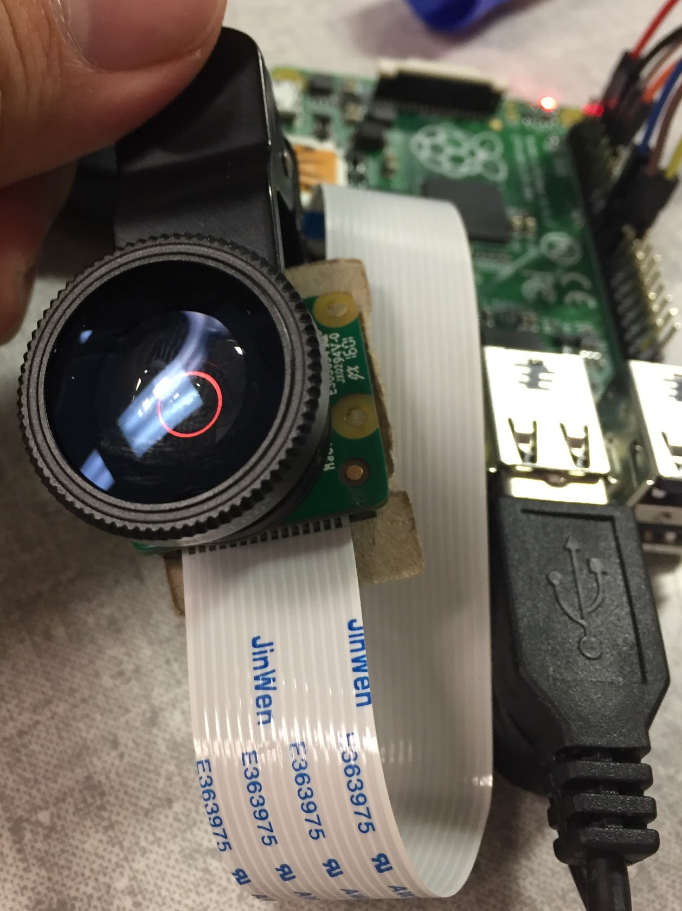
Camera
Takes a picture that captures both eyes
Set in the middle of the goggles
Either above or below the FOV
Uses a Fisheye lens to widen aperture
Raspberry Pi Camera Board v2:
-8 Megapixels
-Max Resolution: 3280 x 2464 pixels
-25mm x 23mm x 9mm
Notes:
Jori

Slide 34
Camera
Requirements
Place inside the goggles (center)
Clearly captures both eyes
Image capture duration: less than .25 seconds
Notes:
Sanghoon

Slide 35
Camera
Speed of image capture & storage
0.65 s
Resolution
Adjustable, currently 729x300 pixels
Brightness
Adjustable, currently 50%
Notes:
Sanghoon

Slide 36
Camera
Future Goals:
Send image directly to Wink Detector (1/22/17)
Permanently attach fisheye lens (1/22/17)
Mount on goggles (2/8/17)
Notes:
Sanghoon

Slide 37
MDR Deliverables
Projector/Display assembled
Prism Construction
OLED Display Setup
App Layout and partial functionality
Wink detector code for image processing on MCU
Wink Detection code
MCU Move-In
Microcontroller communication setup and data transmission
Notes:
Minwo (make sure to mention the change from the TI chipset)

Slide 38
Proposed CDR Deliverables
Full app functionality (1/22/17)
Communication to and from phone (2/1/17)
Controls to the phone
Image from the phone
Power system setup (2/5/17)
Prototype setup (2/8/17)
Goggles setup with camera and display
Microcontroller switched to RPi Zero
PCB board layout (2/12/17)
Notes:
David

Slide 39
Thank You
Do you have any questions?

Slide 40
Backup Slides

Slide 41
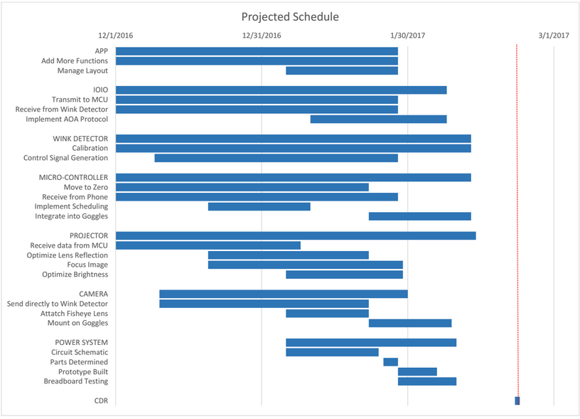

Slide 42
Budget
Spent so far
$49.49
Upcoming costs
IOIO - $60
PCB - $100
Fisheye lens - $15
Breathing Room
$275.51

Slide 43
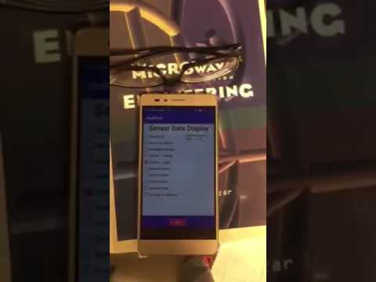
Phone App - Sensor Data Video
Notes:
Minwo

Slide 44
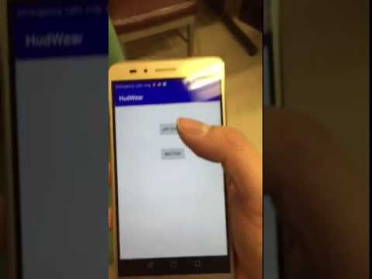
Phone App - Music Video

Slide 45
Sample control system
Right wink: select item
Left wink: change item
Data
Speed
Gravity
Back
Message
Display
Back
Music
Pause/play
Skip
Back

Slide 46
Wink Detector Parameters
Primary
Circle sensitivity
Edge sensitivity
Blur
Secondary
Distance between circles
Max and min sizes
Camera settings
Image resolution
Contrast
Brightness

Slide 47
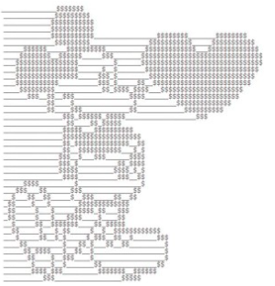

Phone App - Generate Display (Minwo)
Image Processor
Generate and send out images
Receive and decode images
Message, timing, GPS map, etc
User Interface
Source of data
Processor of the project
Notes:
Minwo

